Slide 1
Employing ReCON for Optical Wave Gauging with Deep Neural Networks in the Great Lakes Nearshore
Nicholas Catanzaro

Slide 2
Acknowledgement
I am currently residing on and studying the land and waters of the Anishinabek Three Fires Confederacy tribes of the Ojibwe, Odawa, and Potawatomi, among other Indigenous peoples in Michigan and across the Great Lakes Region.

Slide 3
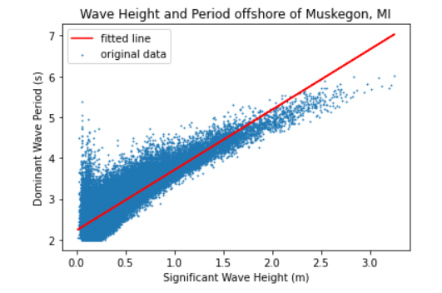
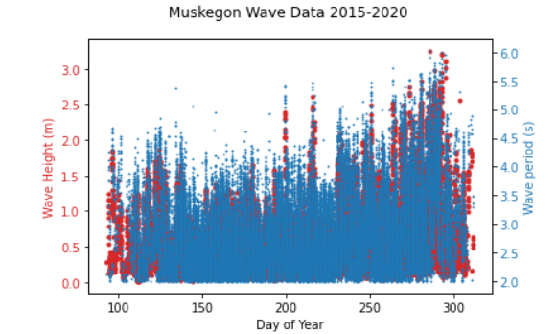
Quick Great Lakes Facts
Surface area: 94,250 mi²
Comprised of Lakes Superior, Michigan-Huron, Erie, and Ontario
Constitute almost a quarter of the Earth’s surface freshwater
Waves are formed by local wind conditions and are typically steeper and have a shorter period compared to ocean waves
NOAA’s Great Lakes Environmental Research Lab (GLERL) maintains the Real Time Coastal Observation Network (ReCON) that collects images and meteorological data in 4/5 Great Lakes

Slide 4
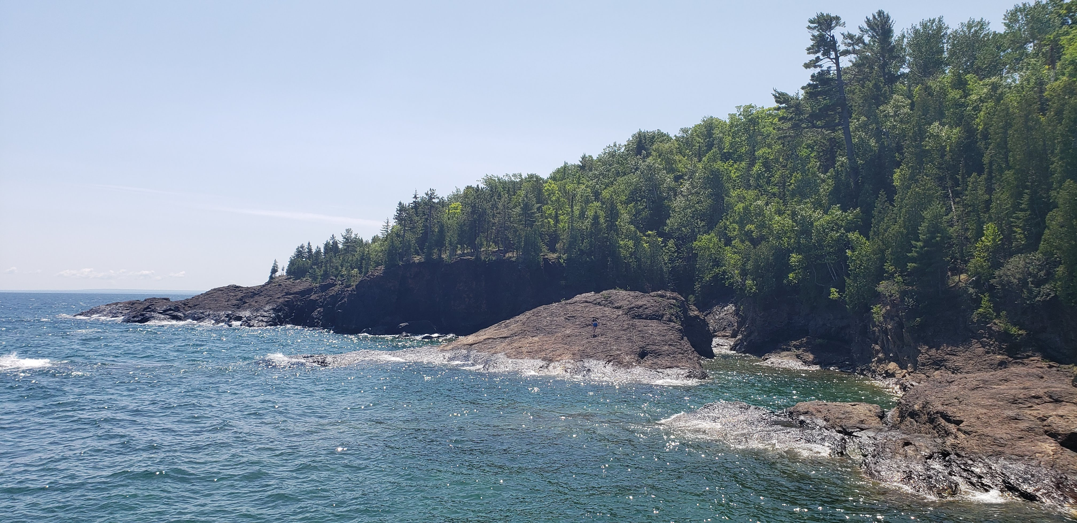
Black Rocks: Marquette, MI
Image provided by Nicholas Catanzaro

Slide 5
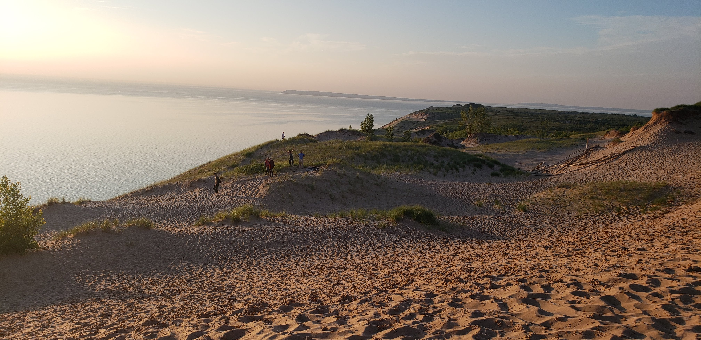
Sleeping Bear Dunes: Empire, MI
Image provided by Nicholas Catanzaro

Slide 6
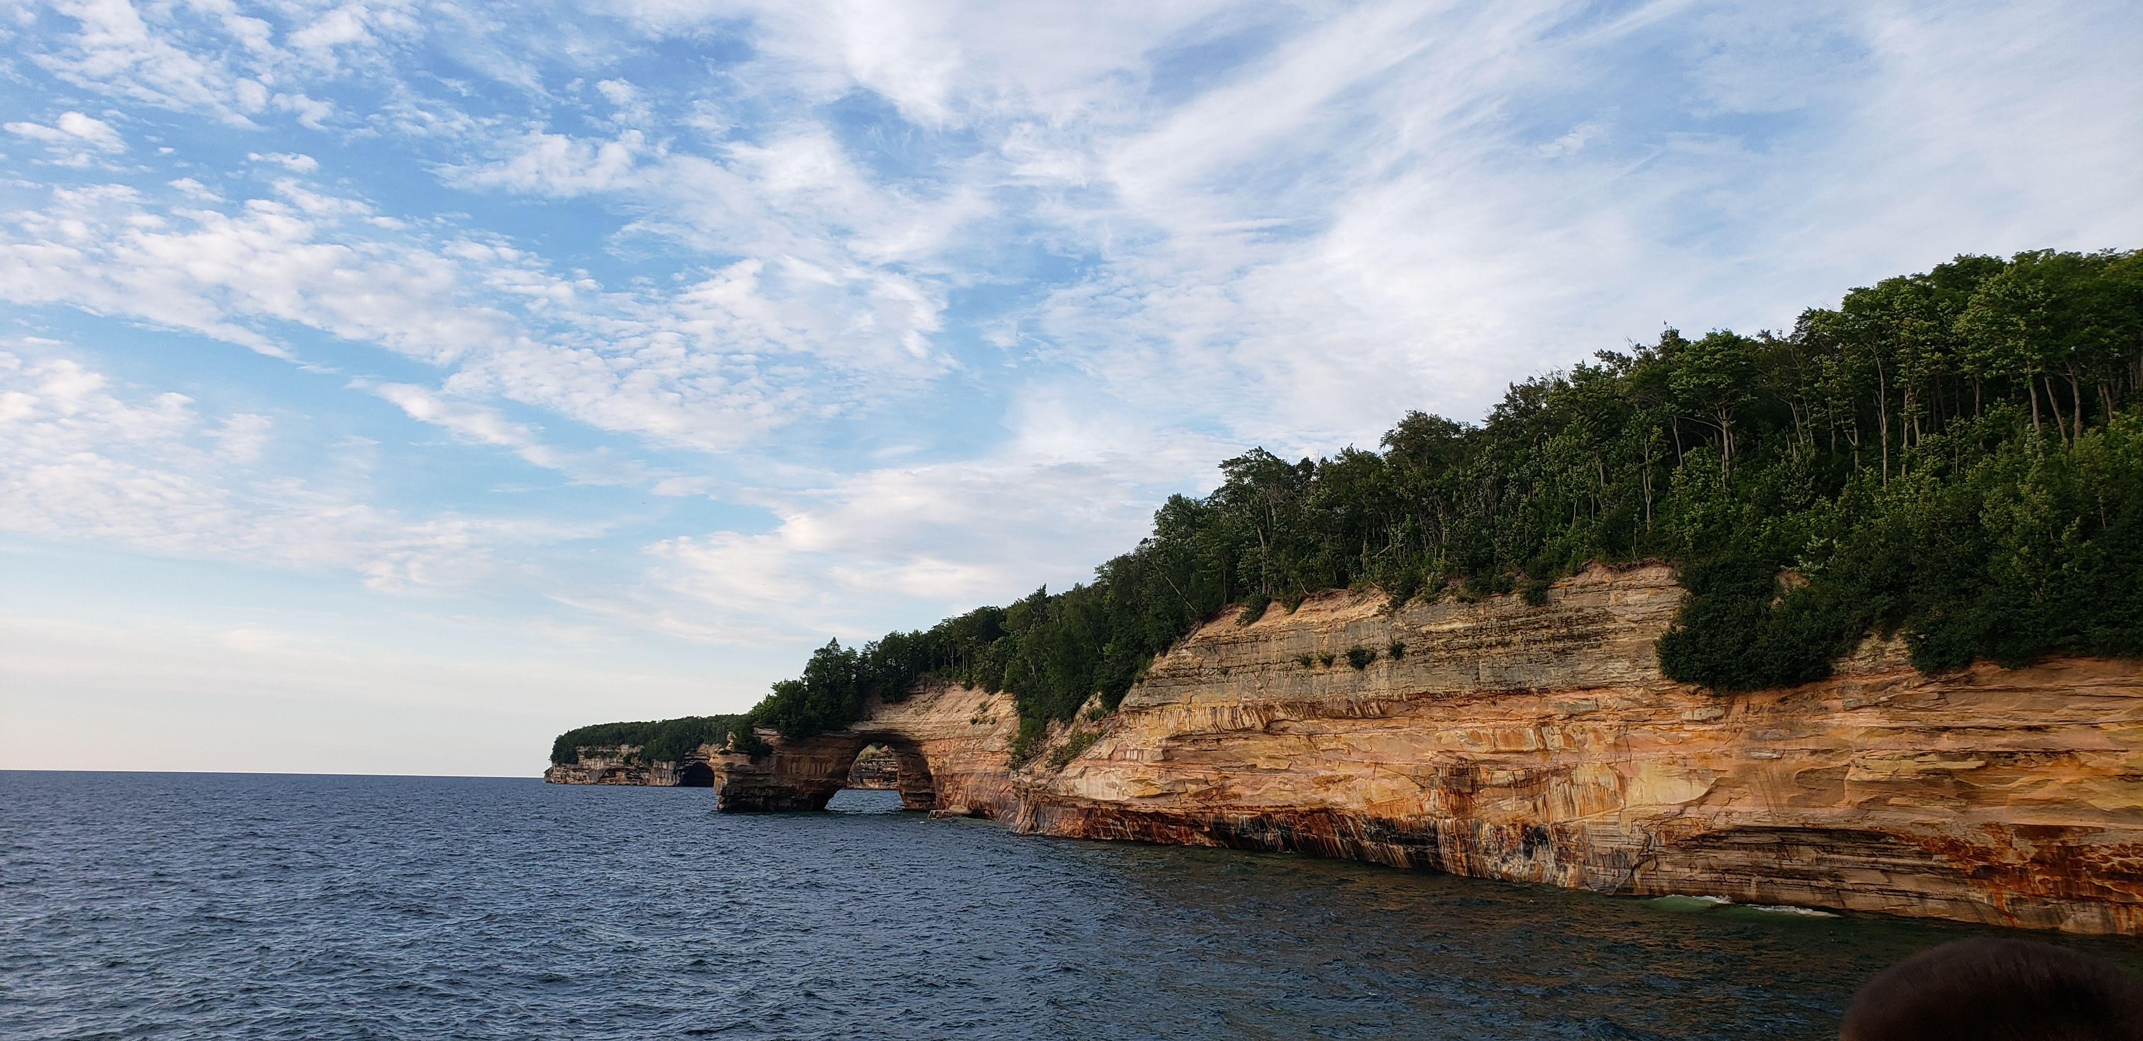
Pictured Rocks: Munising, MI
Image provided by Nicholas Catanzaro

Slide 7
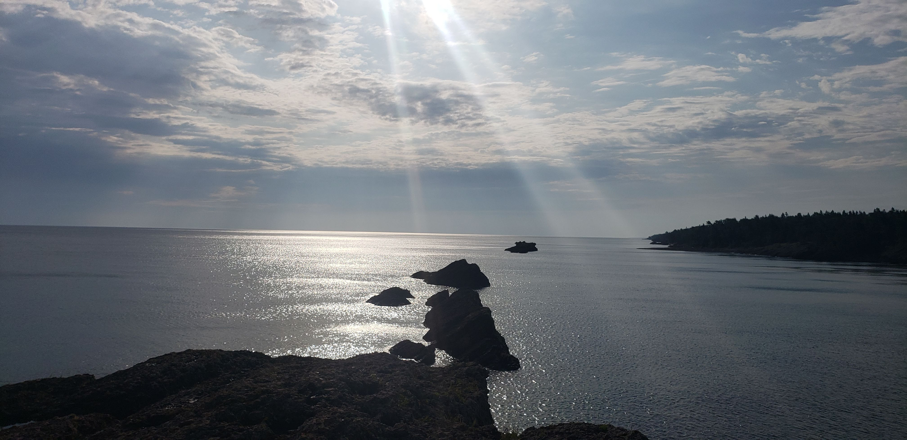
Mary Macdonald Preserve at Horseshoe Harbor: Copper Harbor, MI
Image provided by Nicholas Catanzaro

Slide 8
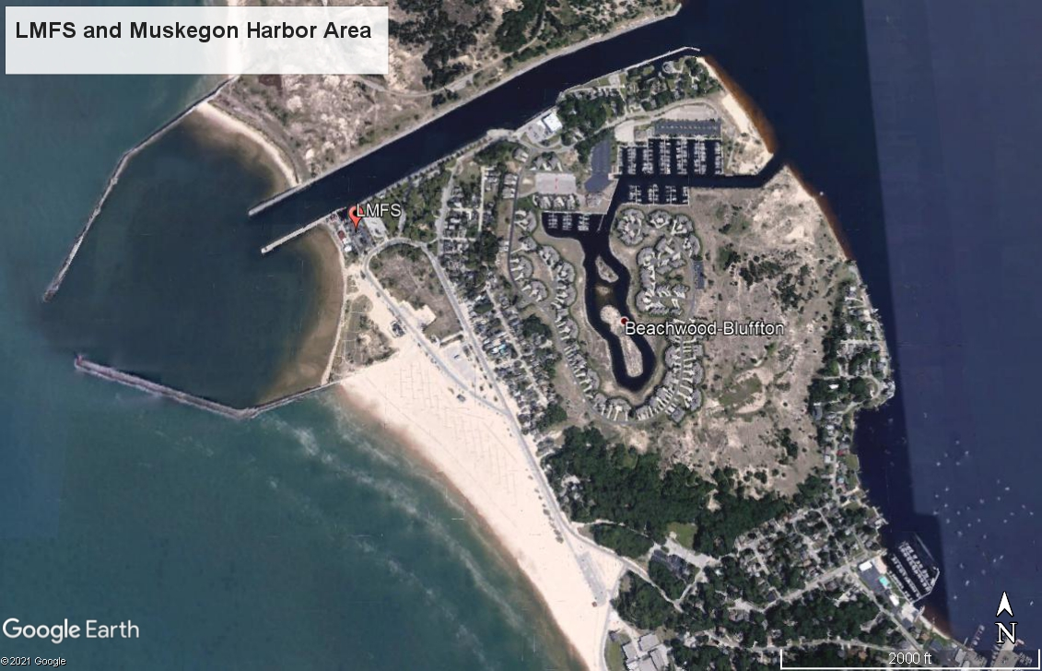
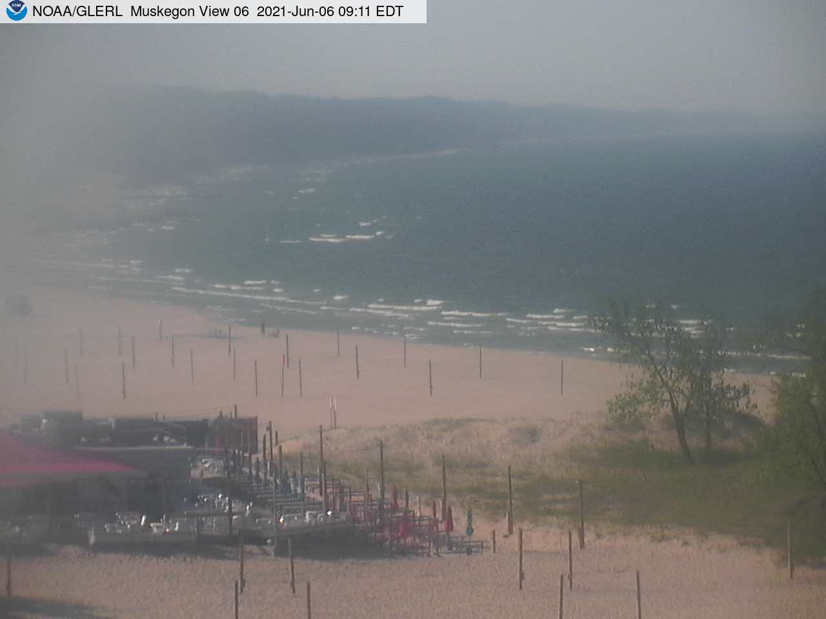
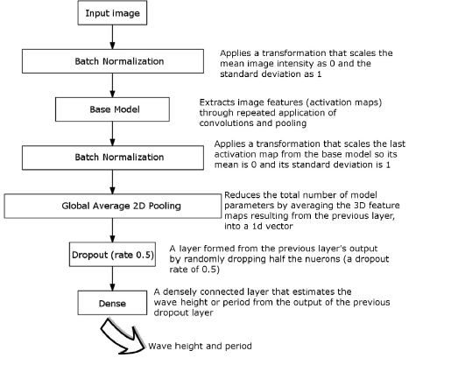
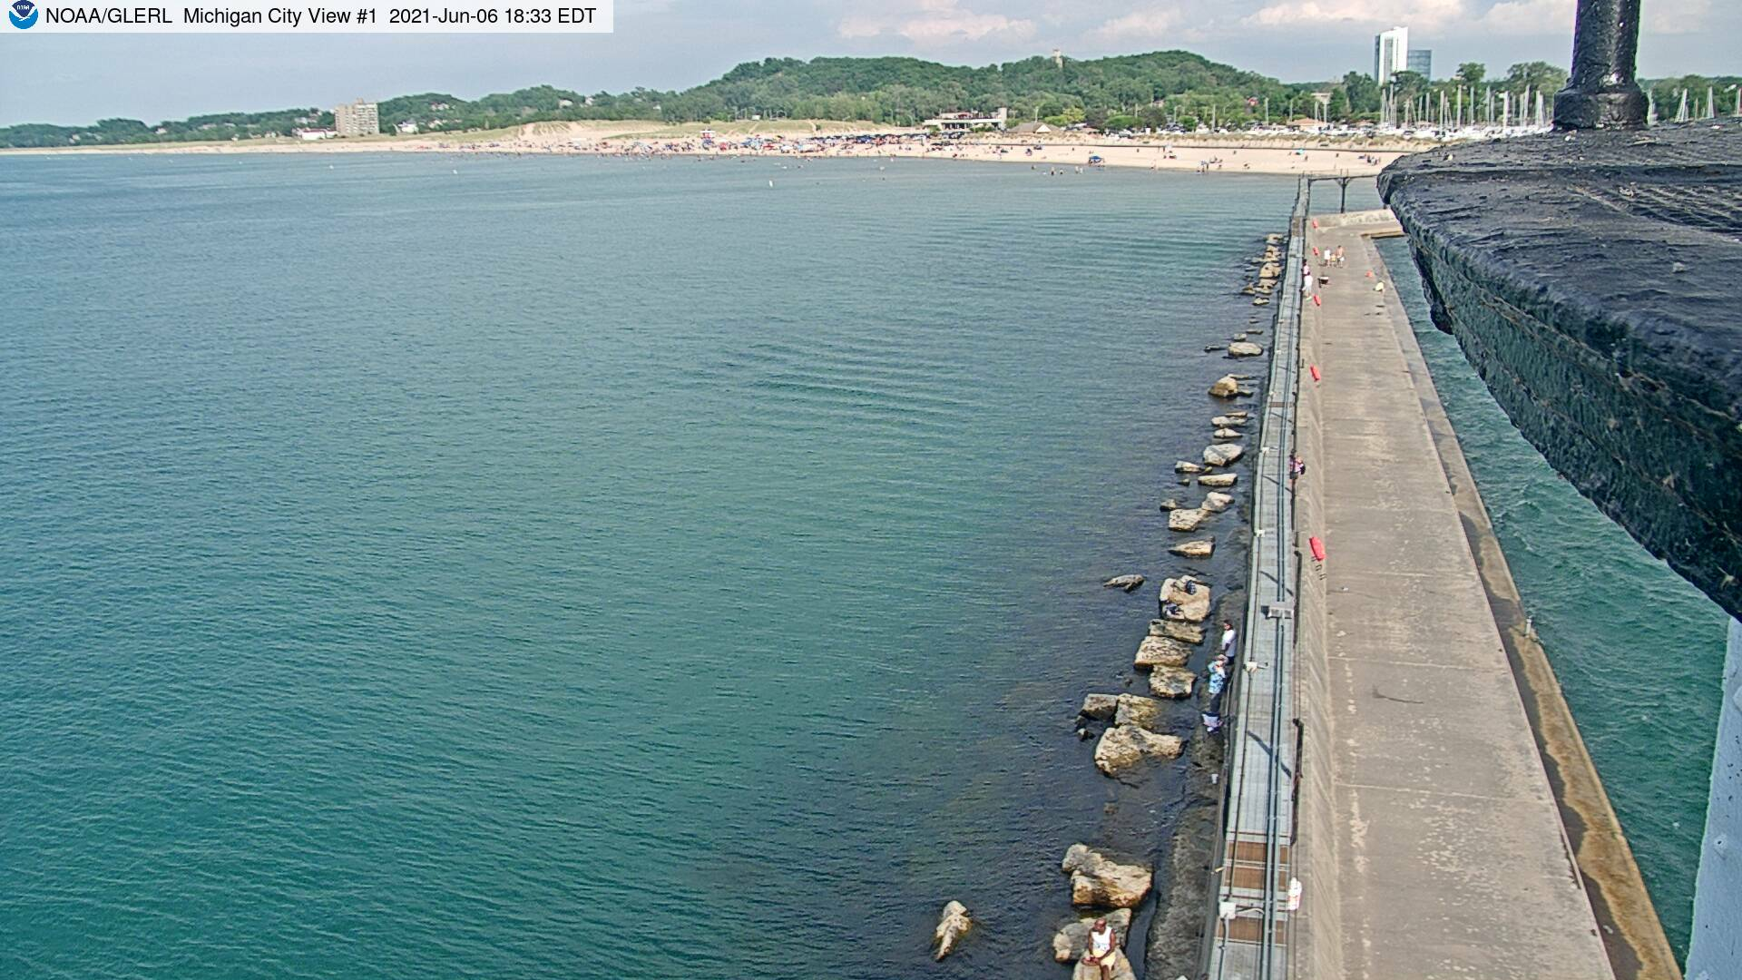
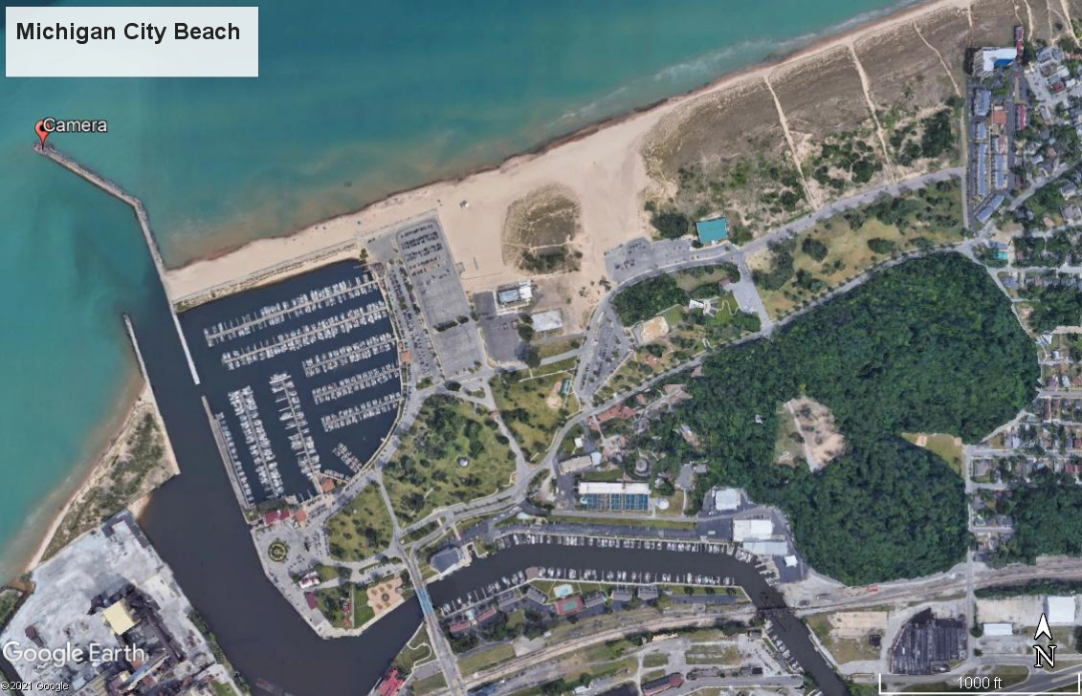
What is an OWG?
Optical wave gauges use data from instrumentation detecting visible light (in this case a webcam) to return measurements about current wave conditions.
The model I am using uses deep learning, a subdiscipline of machine learning, to recognize patterns in the waves by recognizing patterns between images and buoy data.
Buscombe et al., 2020

Slide 9
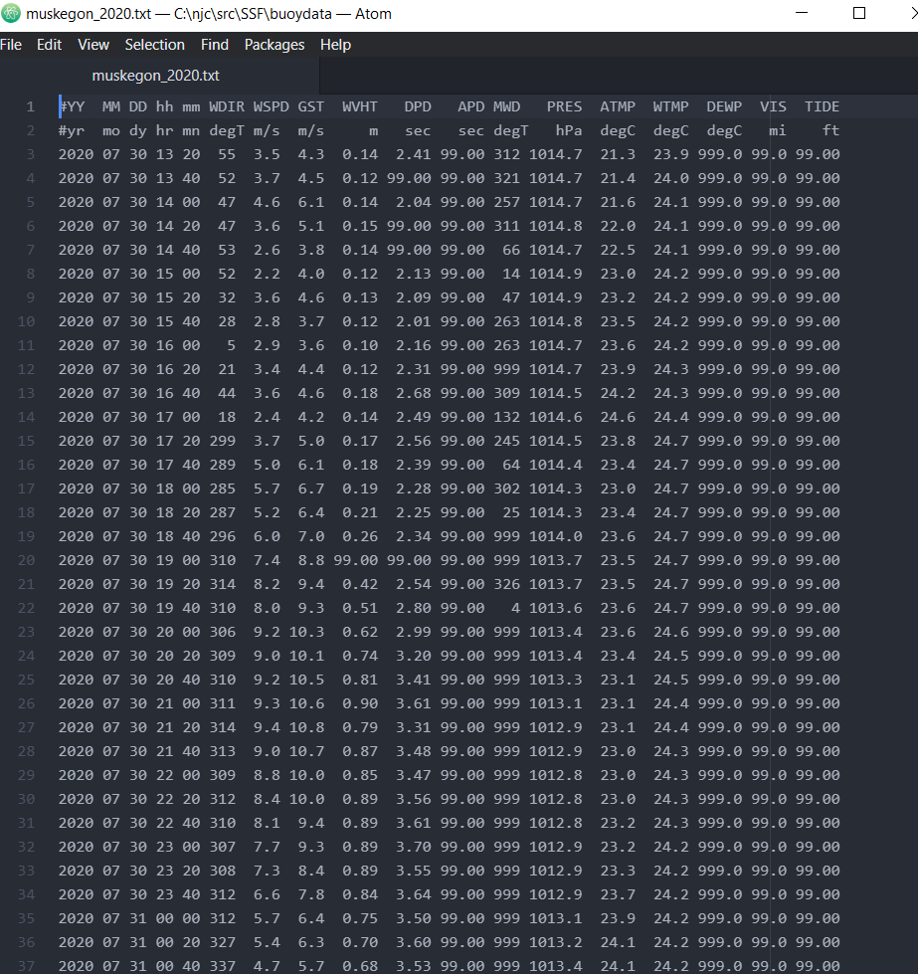
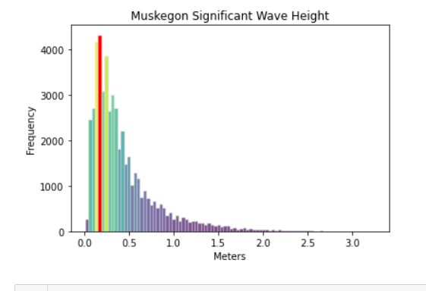
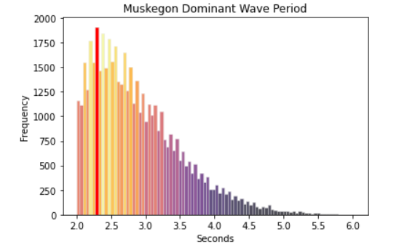
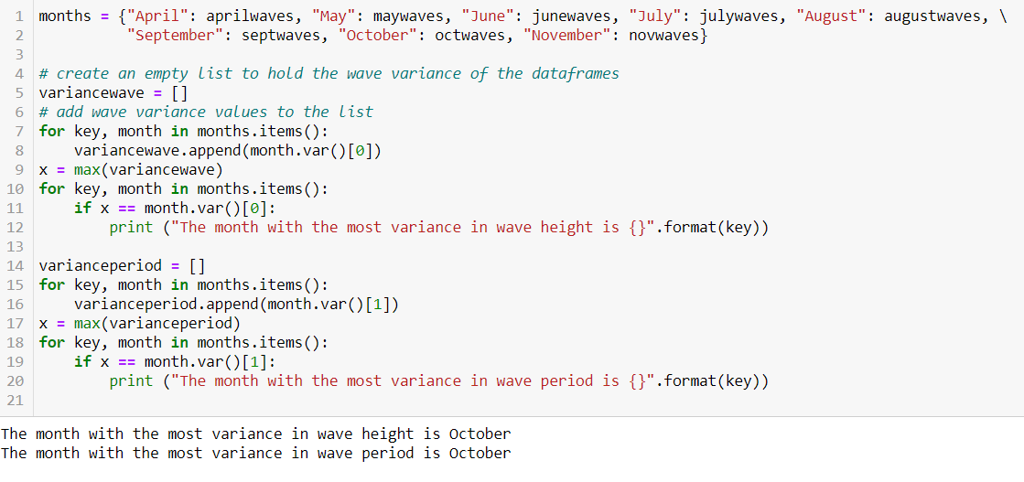
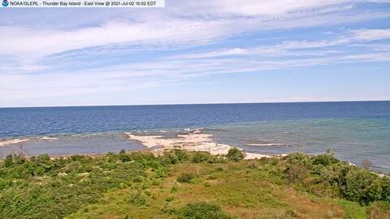
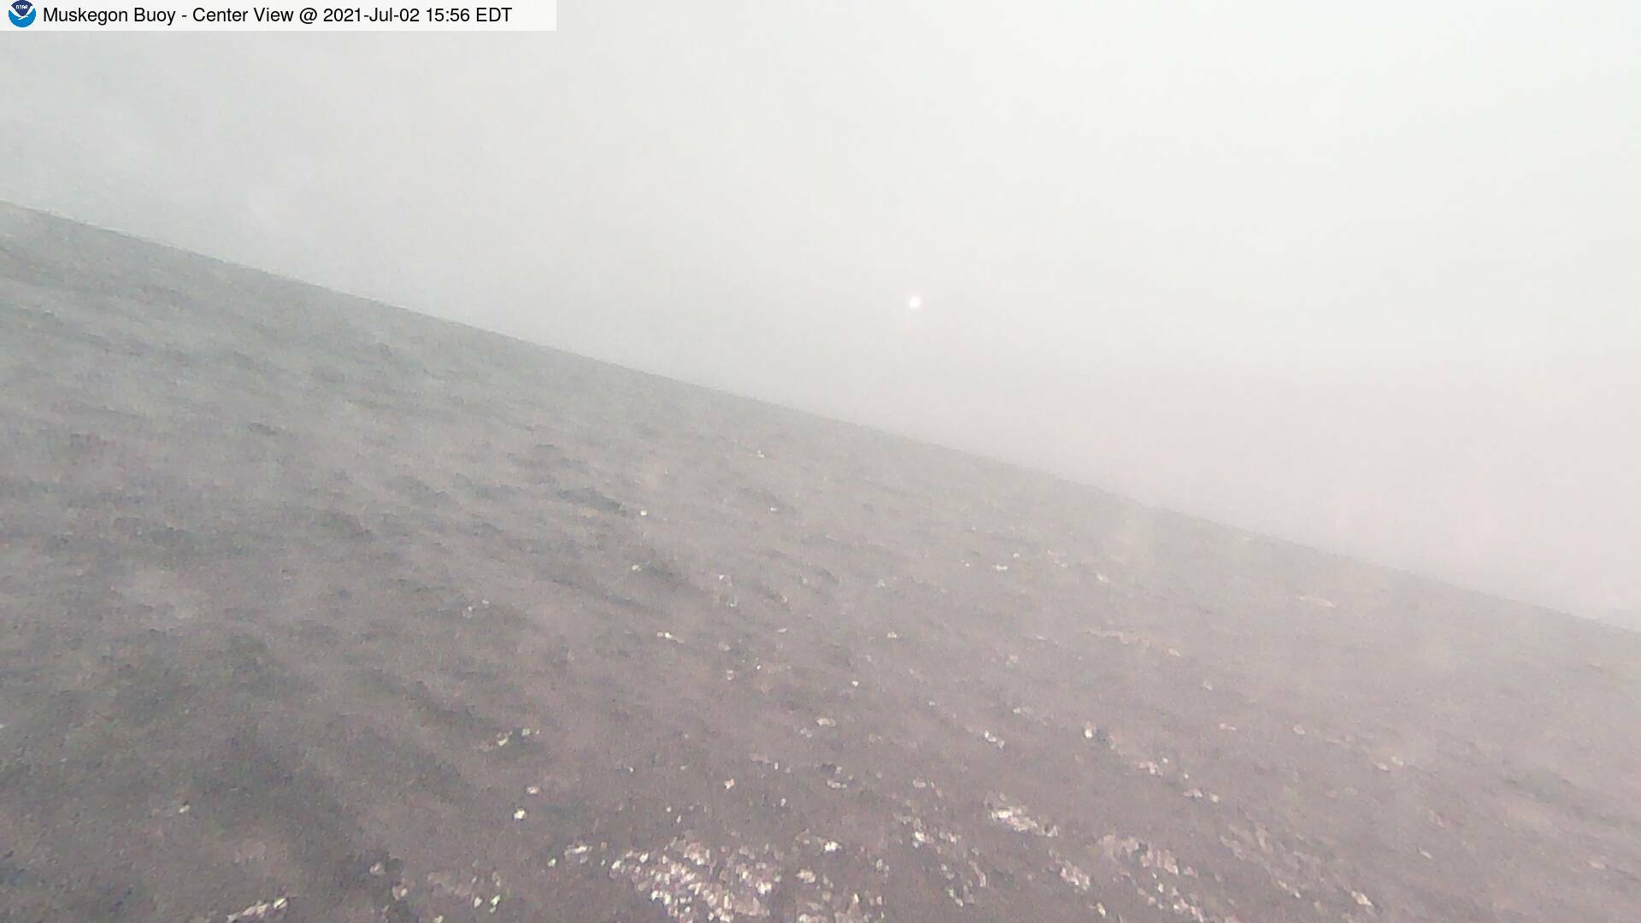
Training Data
Buoy Data
Webcam Data

Slide 10
Impact
In situ wave sensing instrumentation is removed in early October to avoid damage from lake ice and storms.
This creates a gap in the data during the significant period of time where buoy data is unavailable, but there is still open water on the lakes.
Precise wave data (within 10cm accuracy) can be used to assess on the water safety conditions, predict coastal change, validate marine weather forecasting, and provide crucial data for a number of numeric coastal change and hazard models.
While OWG’s have been successfully deployed on ocean coasts (Buscombe et al, 2020), ReCON imagery has never been used to train OWG’s in the Great Lakes.

Slide 11
Future Directions
Collaborate with the NOAA Great Lakes Environmental Research Laboratory’s Observation Systems & Advanced Technology team to make the OWG available to researchers and stakeholders.

Slide 12
Works Cited
Daniel Buscombe, Roxanne J. Carini, Shawn R. Harrison, C. Chris Chickadel, Jonathan A. Warrick, Optical wave gauging using deep neural networks, Coastal Engineering, Volume 155,2020,103593,ISSN 0378-3839, https://doi.org/10.1016/j.coastaleng.2019.103593.
(https://www.sciencedirect.com/science/article/pii/S0378383919301243)

